Slide 1

STAR APP
March 18, 2023
Notes:
40 sec(Prep, Index, Project Overview)

Slide 2
Index
Project Overview
Architecture
Entity Relationship Diagram
Application Programming Interface
Process
Quality Assurance
About Us
Future Scope & Learning
Notes:
40 sec(Prep, Index, Project Overview)

Slide 3


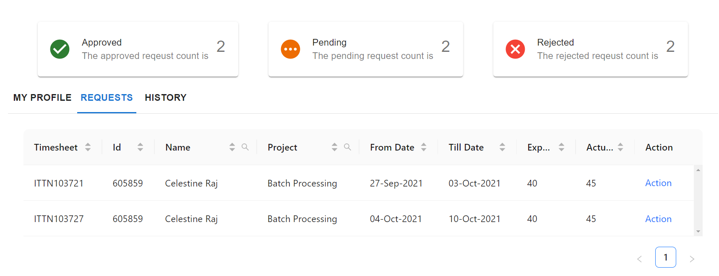
Project Overview
20
10
25
30
20
30
40
40
20
Notes:
40 sec(Prep, Index, Project Overview)

Slide 4
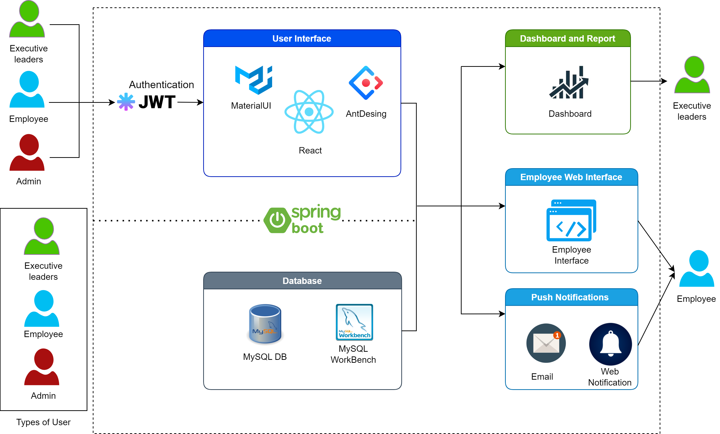




Architecture
Reusability
Achieved reusability via reactJS and Java Spring Boot
Easy To Maintain
MVC architecture in itself is highly maintainable
Component based designing provides easy maintenance
Easy To Use
UI design is user friendly
De-coupled Database
Spring Boot framework and JPA makes our WebApp DB independent
Notes:
90 sec(Arch)

Slide 5
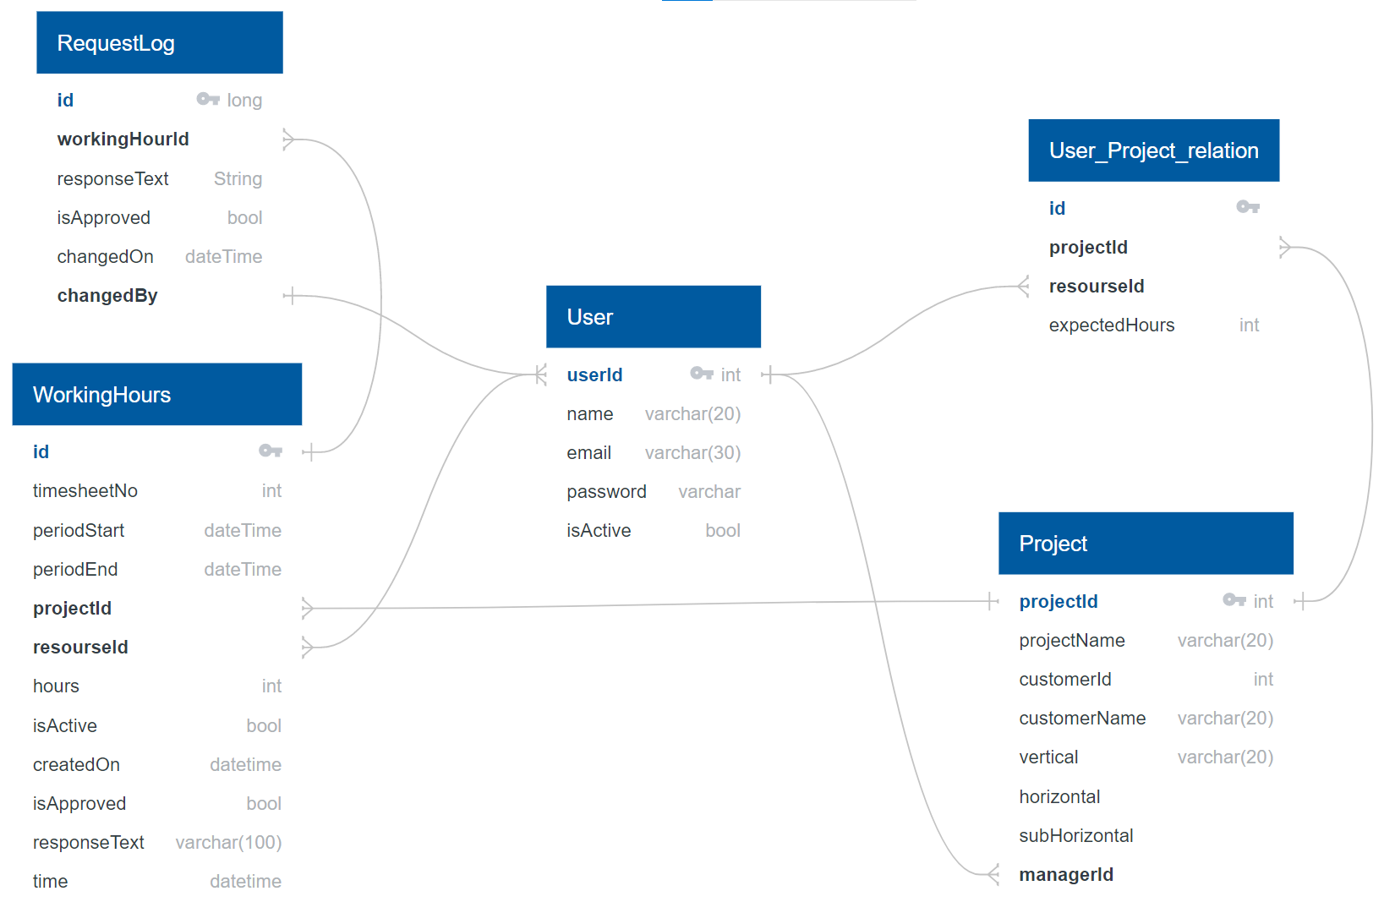
Entity Relationship Diagram(ERD)
DB Considerations
Business Requirements Accurately capture and track employee work hours and project activities
RDBMS Our requirements could be best represented using a RDBMS
Normalization Our data is normalized to minimize redundancy and ensure data consistency
Data Source currently our data source timesheets that are provided in form of excel sheets
Notes:
25 sec(ERD, API)

Slide 6
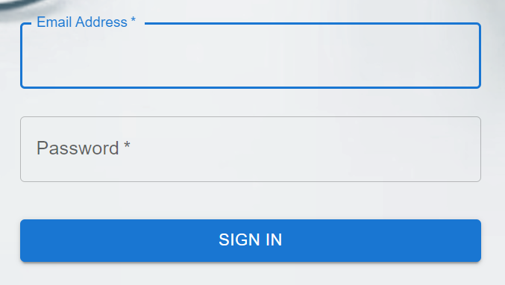
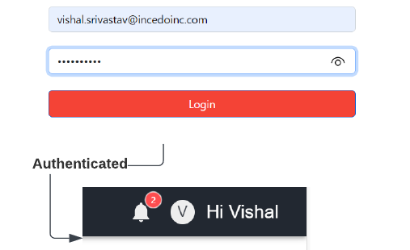
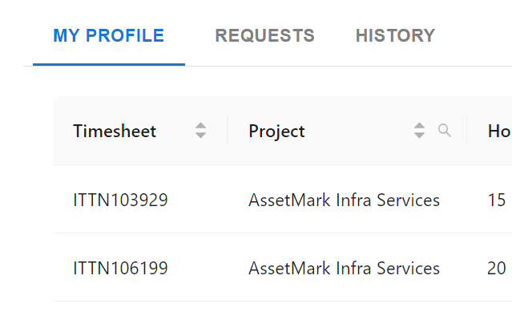
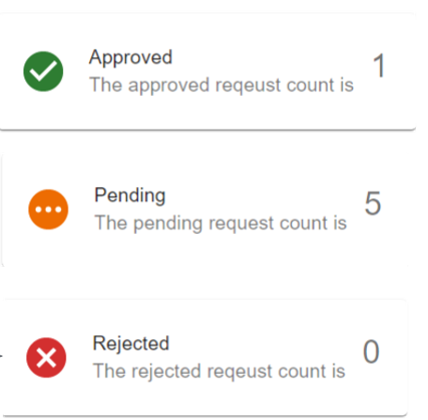
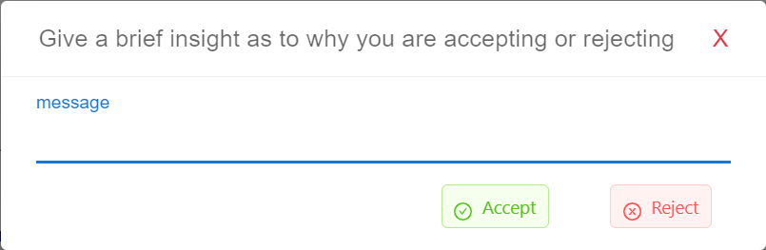
Application Programming Interface(APIs)
User Details
Request APIs
Authentication Generates and authorizes JWT token
User Data Fetches User Data
My Profile Get all request and its status for user
Manager Requests Get pending requests of User
Change Log Get change log of requests
User Status APIs
Notification APIs
Status Gets the count of each type of request for resources and managers
Send Mail Notify users via mail
Push Notification Show bell notification to user on landing page
Notes:
25 sec(ERD, API)

Slide 7
Process
Weekly Sprints
Milestones
Q1-2021
Deliverables
Q4-2021
Starting the Project
Feasibility Study
Database Modelling
Wireframe
Product backlog
Entity Relationship Diagram
Wireframe document
Open
Open
Open
Sprint 1
Discovery Phase
Design & Development Phase 1
UI design
User authentication
Backend APIs
Quality Control
API testing report
Manual testing report
Open
Open
Sprint 2
Key Pointer 2
Backend and Frontend Integration
Feature addition: Notification Request Filters Request Change Log
Sonar Cloud Integration Report
Automation testing reports
Prototype
Open
Open
Design & Development Phase 2
Sprint 3
Finishing the Project
Documentation
Project Presentation
User Manual
Open
Review & Closure
Sprint 4
Key Pointer 3
Ceremonies
Sprint Planning | Sprint Grooming | DSU | Parking Lot Meet | Sprint Demo | Sprint Retrospective
Notes:
120 sec(Process)

Slide 8

Quality Assurance
Static application security testing (SAST)
Automated & API test
Sonar Cloud
Sonar Cloud is a cloud-based code analysis service.
TestNG
TestNG is a testing framework for
Selenium
Selenium is open-source automated testing framework
Postman
Postman is an API Platform for developers to design, build, test and iterate their APIs
Notes:
60 sec(QA, Manual Testing, Automation Testing)

Slide 9
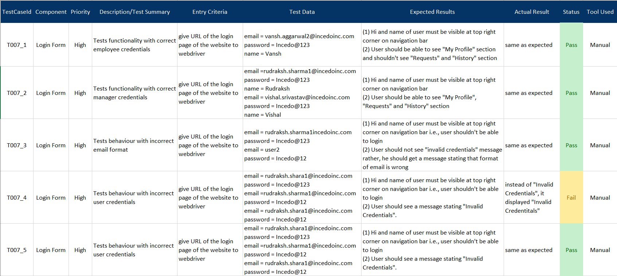
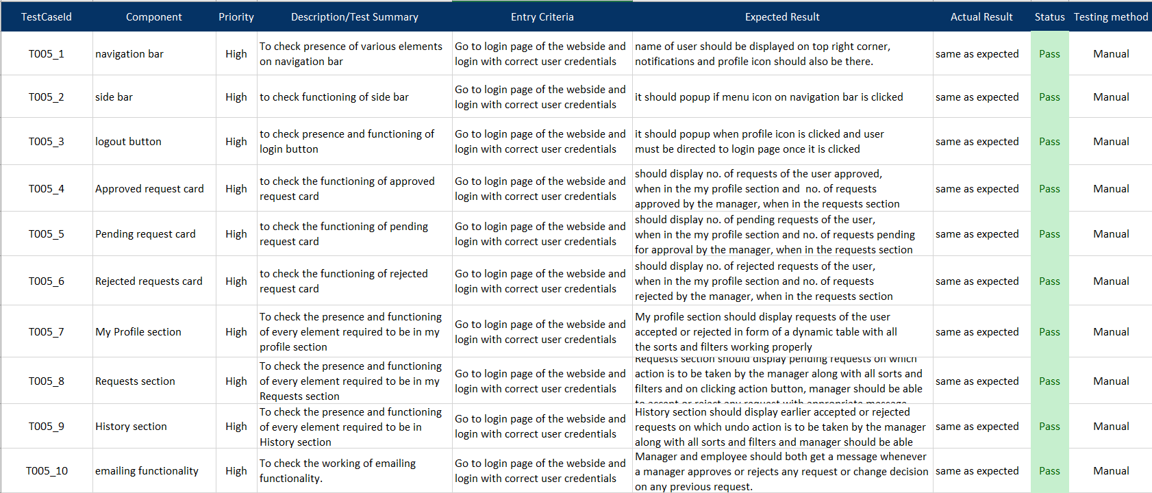

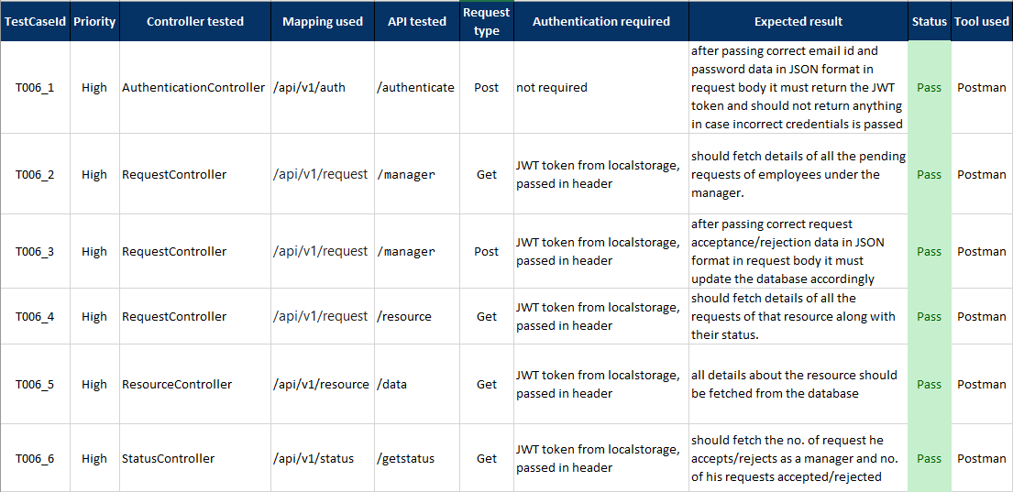
Manual Testing
User Authorization and Authentication
User Dashboard
Open
Open
Backend APIs
Summary
Testing Methods Integration and system testing(Black Box)
Effectiveness We found that are system was responding as per the requirements
Test Cases Total test cases: 28 Focus: Data input, storage and retrieval, systems ability to validate & process
Personal Takeaway Positive: It is less complex, and doesn’t require any prior set-up Negative: takes a lot of time to build test cases and perform testing
Open
Notes:
60 sec(QA, Manual Testing, Automation Testing)

Slide 10
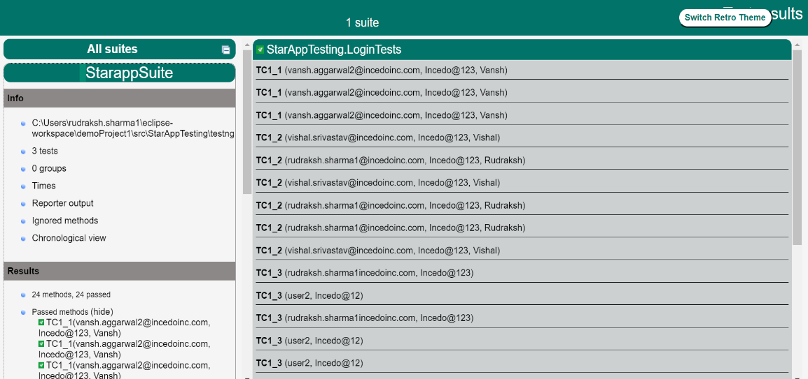

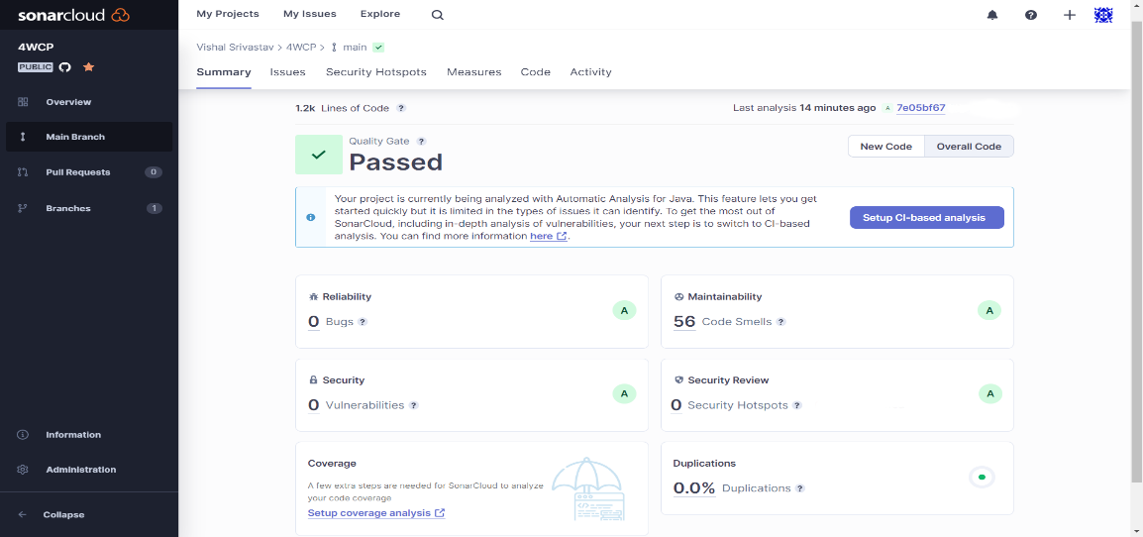

Automated Testing
TestNG Report
Selenium and TestNG summary
Browsers Tested | 3
Thread Count | 3
Test Suites | 1
Total test cases | 24
Passed test cases | 15
Failed test cases | 9
TestNG
Open
Sonar Cloud Report
Sonar Cloud Summery
Blocker issues | 1
Minor issues | 55
Critical issues | 0
Major issues | 0
Unresolved issues | 56
Resolved issues | 16
Sonar Cloud
Open
Notes:
60 sec(QA, Manual Testing, Automation Testing)

Slide 11



Future Scope
Single Sign On
Provide single sign on feature
Cloud
We could increase our scalability by moving to the cloud
21 march 23 - 25 March 23
30 march 23 - 15 April 23
14 march 23 - 21 March 23
26 march 23 - 30 March 23
MS Dynamics
We are looking to integrate Microsoft Dynamics to streamline data management
Analytics
Generate more in-depth reports
Provide Visualization for Managers
Notes:
20 Sec(Future scope, Learning)

Slide 12




Learnings
Kaizen
Kaizen
Teamwork
Steep learning Curves
Teamwork
Teamwork
Take ownership
Pomodoro Technique
Peer learning
Resilience
Agile methodologies
Notes:
20 Sec(Future Scope & learning)

Slide 13

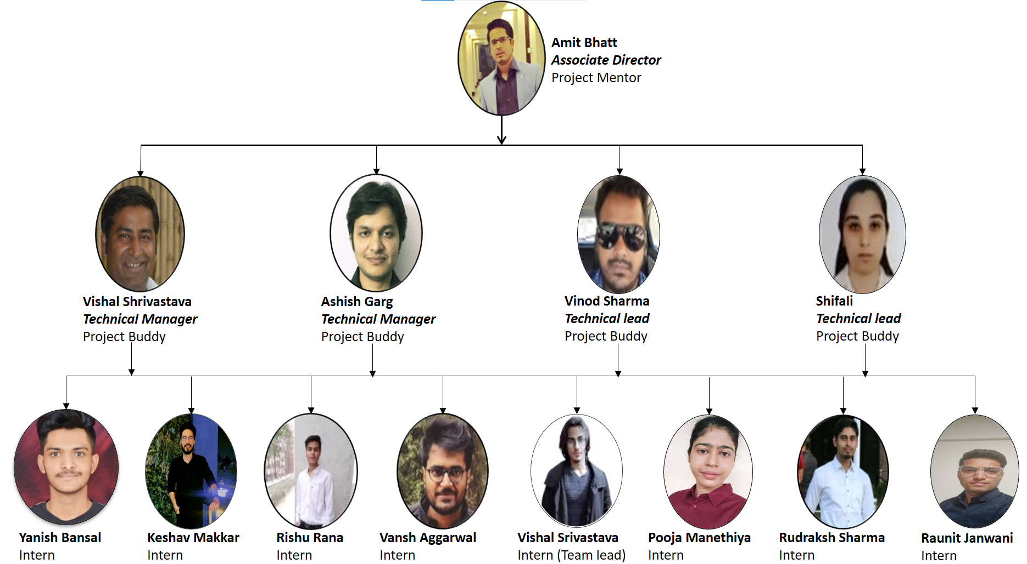
About Us
Notes:
10 sec(About US)

Slide 14
Question & Answers
www.incedoinc.com
Notes:
0 Sec

